Slide 1
jQuery en jQuery Mobile

Slide 2
Inhoudstafel
jQuery
jQuery Mobile
Pages & Dialogs
Transitions
Themes
Widgets
Buttons
Navigation Bar
Listview
Accordion
Forms
Events

Slide 3
JQuery

Slide 4
jQuery
Javascript Framework
DOM
AJAX
CSS

Slide 5

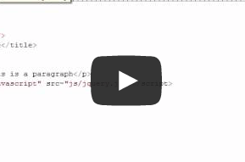

TheNewBoston.org

Slide 6
jQuery Mobile

Slide 7
jQuery Mobile
Web: Javascript + CSS
Touch optimized
Compatibiliteit (http://jquerymobile.com/gbs/)
Firefox Desktop 10-18
Internet Explorer 8-10
Chrome Desktop 16-24

Slide 8
jQuery Mobile Structuur
<div data-role=“page”>
<div data-role=“header”></div>
<div data-role=“content”></div>
<div data-role=“footer”></div>
</div>

Slide 9
Pages & Dialogs
1 HTML document mogelijk
Automatische toevoegingen (back buttons)
Pagina of pop-up Dialoog automatische detectie (data-rel=“dialog”)

Slide 10
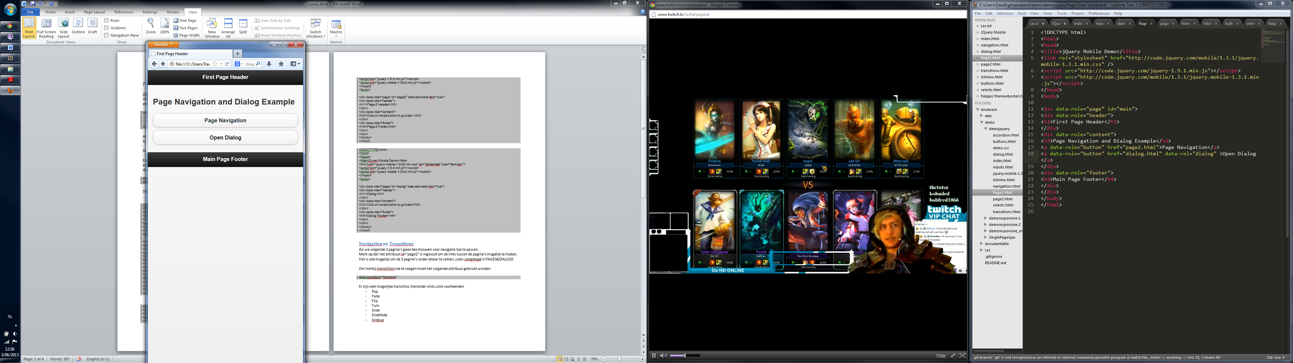
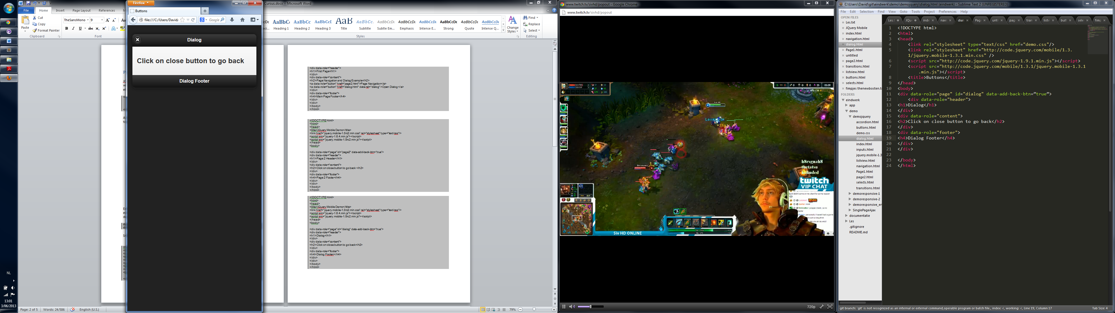
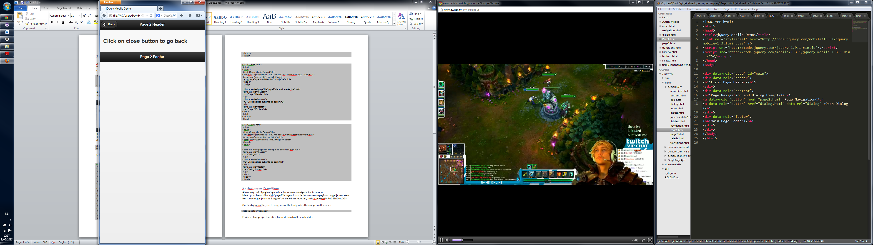

Slide 11
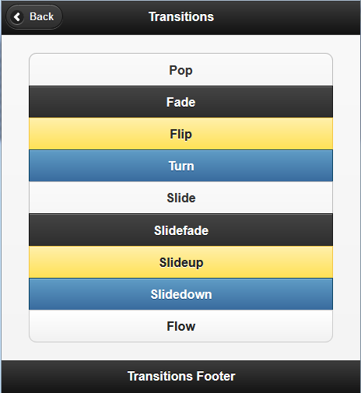
Transitions
Data-transition=“…”
Pop
Fade
Flip
…

Slide 12
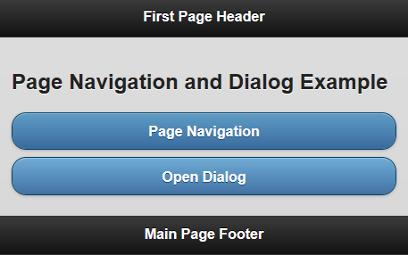
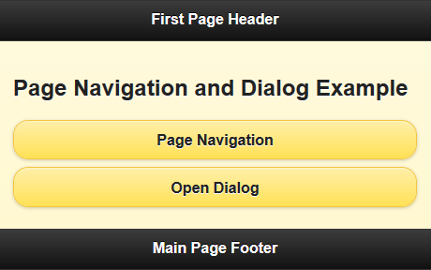
Thema’s
Data-theme=“thema”
Ingebouwde maar ook aanpasbaar
http://jquerymobile.com/themeroller/

Slide 13
Widgets: Buttons
<a>
Data-role=“button”

Slide 14
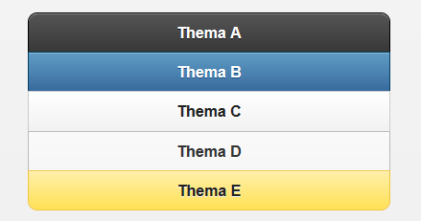
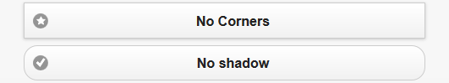
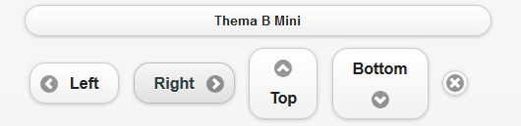
Buttons: Thema en Stijl
Data-theme=“thema”
Data-corners =“false”
Data-shadow=“false”
Data-inline=“true”
Data-mini=“true”

Slide 15
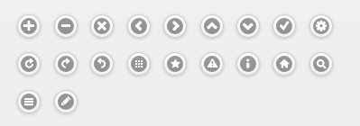
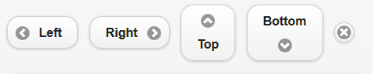

Buttons: Icon
Data-icon=“…”
Custom icon sets
Data-iconpos=“left”
Ui-icon-nodisc

Slide 16
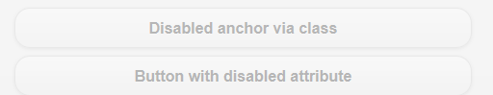
Buttons: Disabled
Class=“ui-disabled”
Disabled=“”

Slide 17
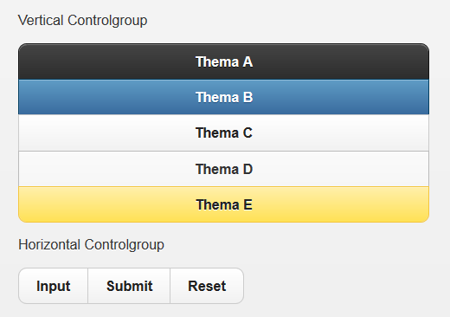
Buttons: Controlgroup
Data-role=“controlgroup”
Data-type=“horizontal” / “vertical”

Slide 18
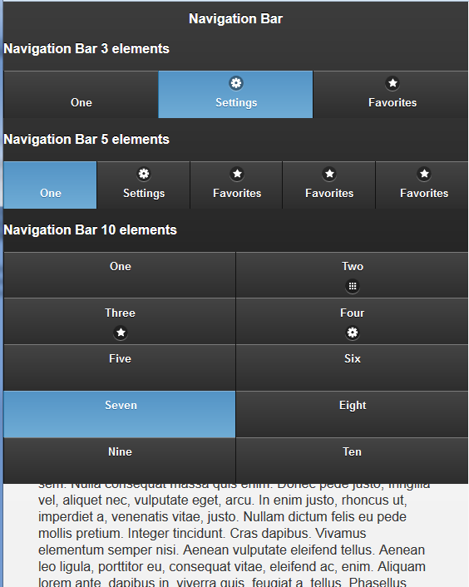
Widgets: Navigation Bar
Data-role=“navbar”
<ul>
<li>…
</ul>
Automatische verdeling (>5)
Class=“ui-btn-active”
Data-position=“fixed”

Slide 19
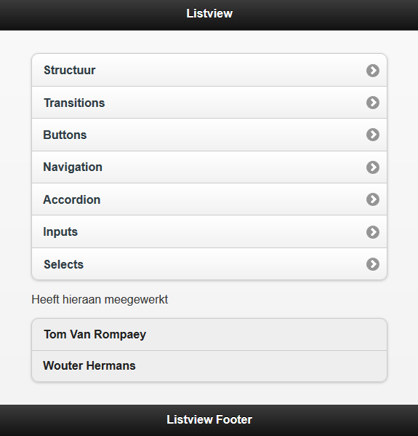
Widgets : Listview
<ul> element
Data-role=“listview”
Gelinkt of niet gelink (icon)

Slide 20
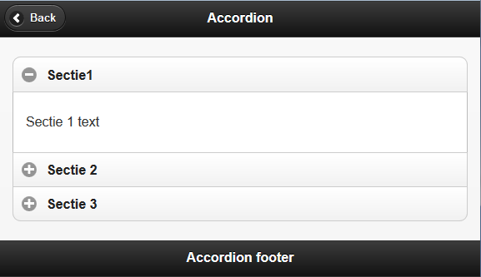
Widgets: Accordion
<div data-role=“collapsible-set”>
<div data-role=“collapsible”>
<h3>Sectie 1</h3>
<p>… </p>
</div>
….

Slide 21
Widgets: Forms
<form> element
<label for=“widget”> met <… id=“widget”>
Retrieve information using jQuery
$(“…”)
- #id
- .class
Vb. $(“p.blauw”) ➔ <p class=“blauw”>

Slide 22
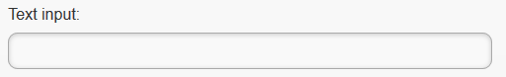
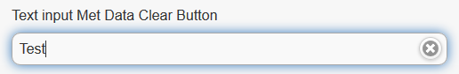
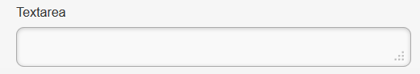
Forms: Inputs
<input> element
Type=“text”
Data-clear-btn=“true”
Placeholder=“”
<textarea> element
Cols, rows

Slide 23
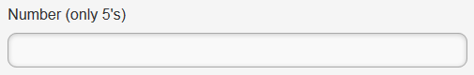
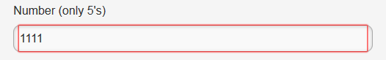
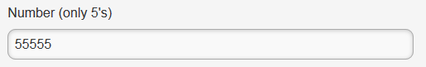
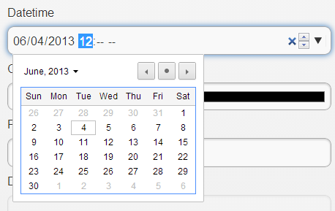
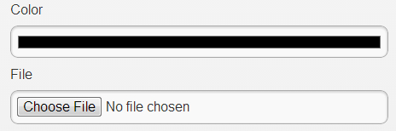
Forms: Inputs
Type=“number”
Pattern=“REGEX”
vb: [5]*
Type=“datetime-local”
Type=“color”
Type=“file”

Slide 24
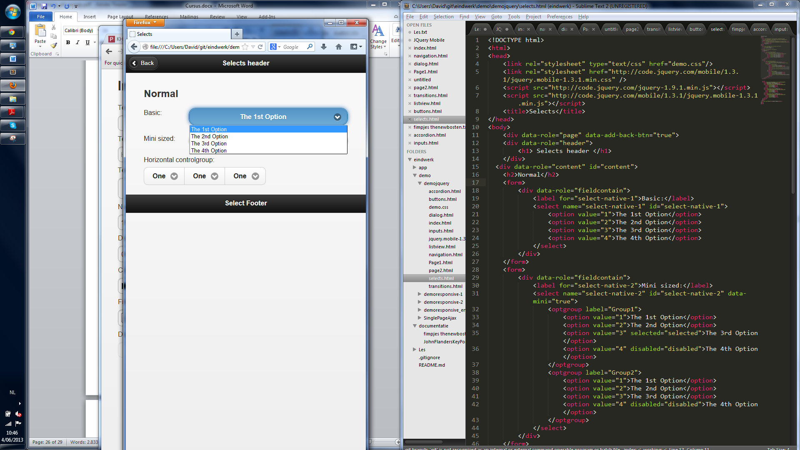
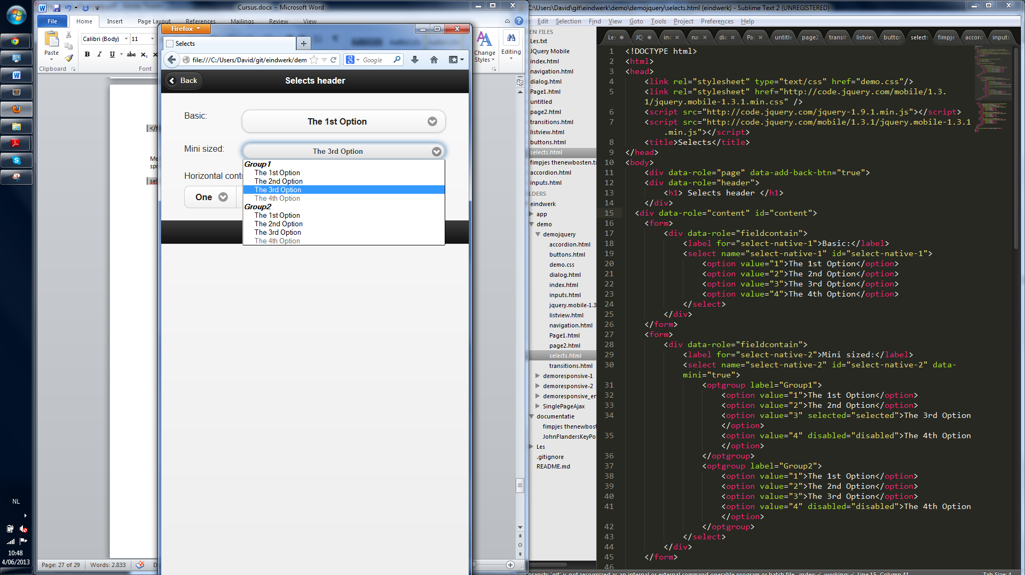
Forms: Selects
<select> element
Selected=“selected”
<optgroup>
label

Slide 25
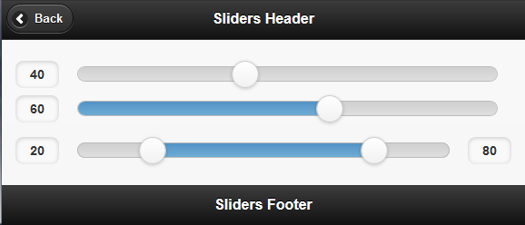
Forms: Sliders
Type=“range”
Value, min, max
Data-highlighted=“true”
div data-role=“rangeslider”
2x input type=“range”
max == max && min == min

Slide 26
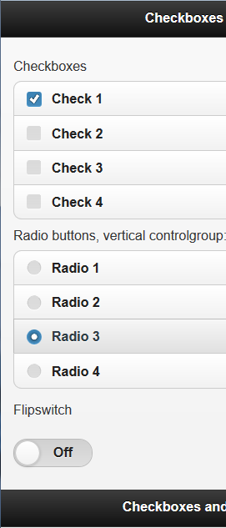
Forms: Checkboxes & Radiobuttons
Type = “checkbox”
Type = “radio”
Checked=“checked”
Flipswitch:
<select data-role=“slider”>
<option value=“off”>Off</option>
<option value=“on”>On</option>

Slide 27
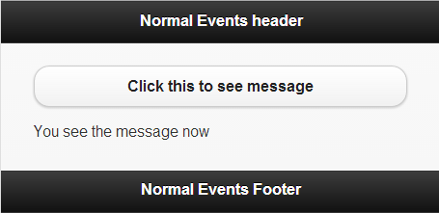
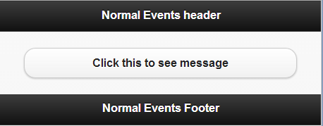
Events
.bind(“event”, function());
$(document).ready(function(){
//alle bindingen
}

Slide 28
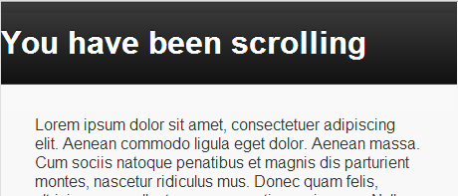
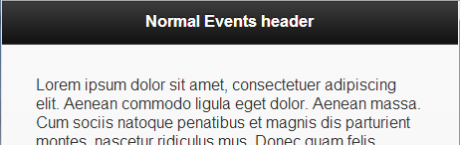
Events: Scrolling
.bind(“scrollstart”,…)
Scrollstart niet overal ondersteund
.bind(“scrollend”,…)

Slide 29
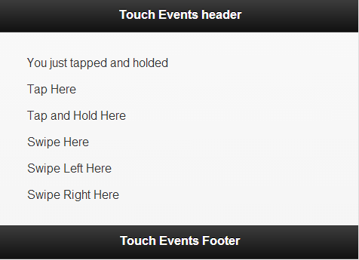
Events: Touch
.bind(“tap”,…
.bind(“taphold”,…
.bind(“swipe”,…
.bind(“swipeleft”,…
.bind(“swiperight”,…
Hammer.js

Slide 30
Events: Orientation
Bind(“orientationchange”, function(){
//bvb refresh layout
});

Slide 31
Events: Mouse Events
Virtual Mouse Events
Differentieren van touch events (hover,…)
.bind(“vmouseover”,…
.bind(“vmousemove”,…
.bind(“vmousedown”,…
.bind(“vmouseup”,…
.bind(“vmouseclick”,…
.bind(“vmousecancel”,…

Slide 32
Events: Page Initialization
.bind(“pagebeforecreate”,…
.bind(“pagecreate”,…
.bind(“pageinit”,…
➔ $(document).ready()

Slide 33
Events: Page Load and Remove Events
.bind(“pagebeforeload”,…
.bind(“pageload”,…
.bind(“pageloadfailed”,…

Slide 34
Events: Page Change Events
.bind(“pagebeforechange”,…
.bind(“pagechange”,…
.bind(“pagechangefailed”,…

Slide 35
Events: Page Transitions
.bind(“pagebeforehide”,…
.bind(“pagehide”,…
.bind(“pagebeforeshow”,…
.bind(“pageshow”,…

Slide 36
Events: Layout Events
.bind(“updatelayout”,…
Vb: Accordions, textareas

Slide 37
Conlusie: jQuery Mobile
Positief
Negatief
Initutief
Snel
Mooi resultaat
Navigatie
Compatibel
Schiet te kort voor complexe app’s
Traag als groot begint te worden
Geen MVC zoals Sensa Touch

Slide 38
Conclusie
jQuery Mobile Cookbook
Chetan K Jain
http://jquerymobile.com/
jQuery onomkeerbaar
Versie 1.3.1. , topje van de ijsberg

Slide 39
Vragen?

